Slide 1
CS195: Computer Vision
Image Segmentation
Foundation Models
Segmentations using a Foundation Model
Monday, October 21st, 2024
CS 195: Computer Vision (Dr Alimoor Reza)

Slide 2
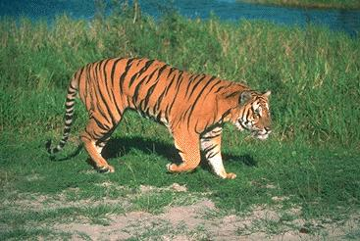
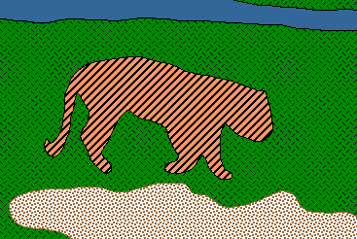
Recap: Image segmentation
Goal: break apart an image into simpler components
CS 195: Computer Vision (Dr Alimoor Reza)

Slide 3
Classical: Clustering Based Segmentation
CS 195: Computer Vision (Dr Alimoor Reza)

Slide 4
Recap: K-means clustering
Randomly initialize the cluster centers, c₁, ..., c_{K}
Given cluster centers, determine points in each cluster
Given points in each cluster, solve for c_{i}
If we run it for enough iterations, it will converge to this state, when the
centers won’t be changing anymore. Clustering mechanism stops.
CS 195: Computer Vision (Dr Alimoor Reza)

Slide 5
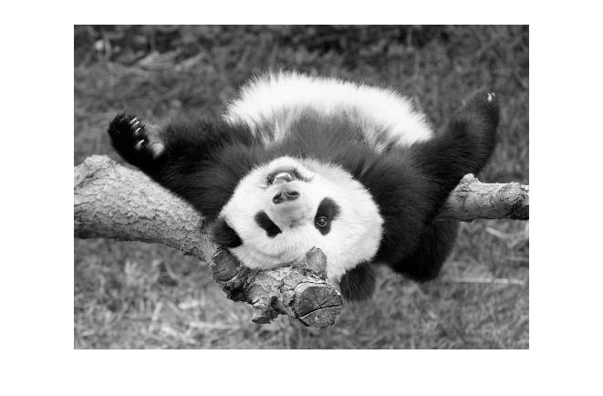
Recap: Segmentation as clustering on a grayscale image
We can customize the clustering by changing the feature space.
e.g. Grouping pixels based on intensity similarity
x-axis denoting different grayscale values
Feature space: 1D gray-scale value
CS 195: Computer Vision (Dr Alimoor Reza)

Slide 6
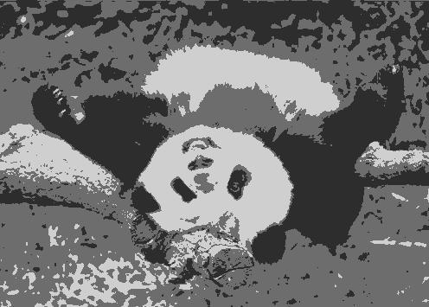
Recap: Segmentation as clustering on a grayscale image
K=2
K=3
CS 195: Computer Vision (Dr Alimoor Reza)
Notes:
They are not coherent and spatially compact regions

Slide 7
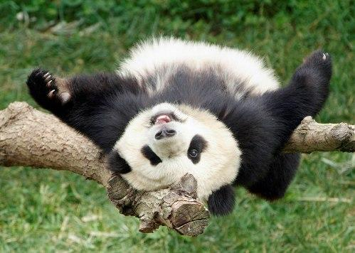
Recap: Segmentation as clustering on a color image
e.g. Grouping pixels based on color similarity
R=255
G=200
B=250
B
G
R=245
G=220
B=248
R
x-axis, y-axis, and z-axis denoting
different color values R, G, B
R=15
G=189
B=2
R=3
G=12
B=2
Feature space: color value (3D)
CS 195: Computer Vision (Dr Alimoor Reza)

Slide 8
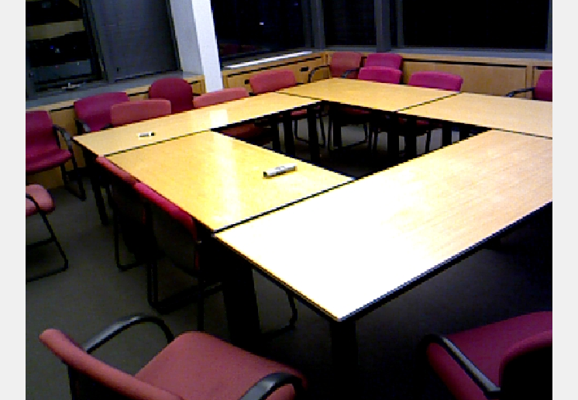
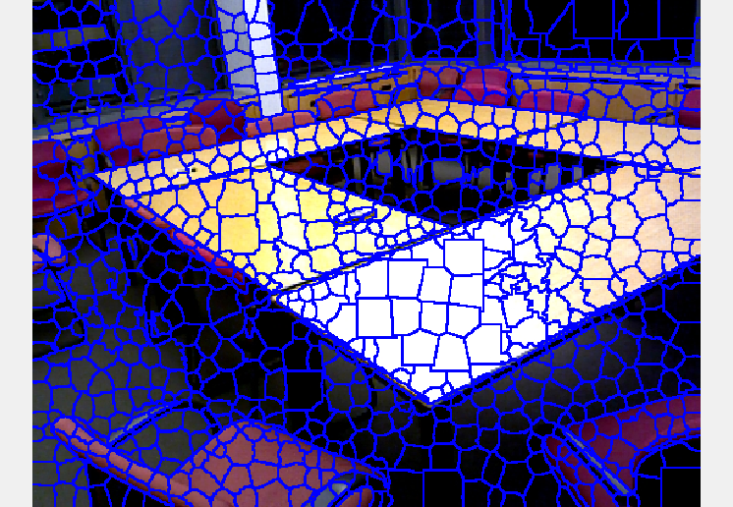
Recap: Simple Linear Iterative Clustering (SLIC)
SLIC clusters pixels in the combined five-dimensional color and image plane space to generate compact, nearly uniform segments (also called superpixels)
Very fast, can generate superpixels in less than a second.
RGB
SLIC superpixels
CS 195: Computer Vision (Dr Alimoor Reza)

Slide 9
Classical: Graph Based Segmentation
CS 195: Computer Vision (Dr Alimoor Reza)

Slide 10
Recap: View image as a graph
Spanning tree 1
Spanning tree 2
CS 195: Computer Vision (Dr Alimoor Reza)

Slide 11
Recap: Minimum Spanning Trees
Suppose edges are weighted, and we want a spanning tree of minimum cost (sum of edge weights)
1
1
14
14
2
2
3
72
100
7
7
33
34
9
9
22
28
24
64
54
54
4
4
15
101
21
11
49
51
11
6
62
6
13
32
12
8
16
12
8
16
10
25
27
5
10
25
5
40
66
CS 195: Computer Vision (Dr Alimoor Reza)

Slide 12
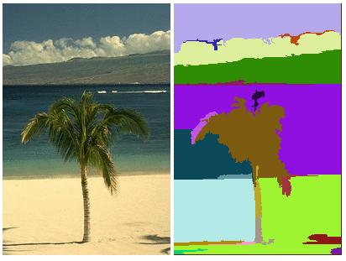
Recap: Back to image segmentation…
Goal: reduce an image to a small number of homogeneous regions (“segments”)
CS 195: Computer Vision (Dr Alimoor Reza)

Slide 13
Recap: Segmentation as a graph problem
Represent an image as a graph
Vertices represent image pixels
Edges between adjacent pixels
Edge weights give difference in color between pixels
5
5
5
0
0
10
15
10
15
10
10
5
5
0
5
5
0
15
10
10
10
15
10
5
0
0
5
5
85
90
90
90
85
90
100
100
100
100
100
100
0
0
0
0
0
100
100
100
60
60
100
0
0
0
40
40
0
0
0
40
0
40
100
100
100
60
50
100
0
0
10
0
0
0
0
0
40
10
50
100
100
50
60
50
60
0
0
50
0
0
40
0
50
10
10
10
CS 195: Computer Vision (Dr Alimoor Reza)

Slide 14
Recap: Segmentation as a graph problem
Goal: Find a small number of homogeneous regions
Or: Find a set of connected components in the graph, such that the sum of edge weights in each component is low
We can do this by finding a minimum spanning tree, and then removing a few high-weight edges
5
0
0
10
15
10
15
10
10
5
5
0
0
15
10
10
10
15
10
5
0
0
5
5
0
85
100
100
100
100
100
100
0
0
0
0
100
100
100
60
60
100
0
0
0
0
0
100
100
100
60
50
100
0
0
0
0
0
10
100
100
50
60
50
60
0
0
0
40
0
10
10
CS 195: Computer Vision (Dr Alimoor Reza)

Slide 15
Deep Neural Network-Based Segmentation
CS 195: Computer Vision (Dr Alimoor Reza)

Slide 16
Foundation Models
A foundation model is any model that is trained on broad data (generally using self-supervision + very large scale) that can be adapted (eg, fine-tuned) to a wide range of downstream tasks
BERT, GPT, CLIP
Foundation models term was used to fill a void in describing the paradigm shift we are witnessing:
Other names are large language models (LLMs), large multimodal models (LMMs)
Foundation models are not new — they are based on deep neural networks and self-supervised learning, both of which have existed for decades. What’s powerful about foundation model is the fact despite not being trained explicitly to do many of those tasks
On the Opportunities and Risks of Foundation Models. Bommasani, R et al. 2021
CS 195: Computer Vision (Dr Alimoor Reza)

Slide 17
Foundation Models
Foundation model is also a deep neural network based model
Its significance can be summarized by two words:
Emergence: the behavior of a system which is implicitly induced rather than explicitly constructed
Homogenization: the consolidation of methodologies for building machine learning systems across a wide range of applications
Notice that each is a subset
of the preceding paradigm
On the Opportunities and Risks of Foundation Models. Bommasani, R et al. 2021
CS 195: Computer Vision (Dr Alimoor Reza)

Slide 18
Machine Learning (1990-2010)
Machine Learning: The rise of ML started in 1990s representing a marked shift from the way AI systems were built previously. Let’s explain it in terms of emergence and homogenization
Emergence: rather than how to solve a task (process), a learning algorithm would implicitly induce “how” based on the data. The how (process) emerges from the learning algorithm. Various machine learning methods were proposed each capable of inducing the “how”
Logistic regression method
Ensemble learning method
Kernel method
Homogenization: wide range of applications could now be powered by a single generic learning algorithm. A single machine learning algorithm can solve a lot of applications.
Housing price prediction task: fit a logistic regression to the household data
Weather prediction task: fit a logistic regression to the weather data
…
You don’t have to explicitly tell how to solve each problem; it will emerge via learning algorithm
Homogenization is the
consolidation of learning
algorithms
On the Opportunities and Risks of Foundation Models. Bommasani, R et al. 2021
CS 195: Computer Vision (Dr Alimoor Reza)

Slide 19
Machine Learning (1990-2010)
Machine Learning: could not cope up with the complex task in computer vision (CV) and natural language processing (NLP). Those complex task still would require some domain expertise to do feature engineering by the humans
Convert raw data eg, image into features/attributes
Geometrical shape features
SIFT feature
HOG feature
Wavelet feature
Mark Zarella, David Breen, Alimoor Reza, Aladin Milutinovic, and Fernando Garcia. Lymph Node Metastasis Status in Breast Carcinoma Can Be Predicted via Image Analysis of Tumor Histology - Journal of Analytical Quantiative Cytopathology and Histopathology'2015
CS 195: Computer Vision (Dr Alimoor Reza)

Slide 20
Deep Learning
(2010-2018)
Computer vision popularized
Deep learning
Deep Learning: Around 2010, represents another shift from the way AI systems were built previously. Let’s explain it in terms of emergence and homogenization
Emergence: rather than feature engineering, deep learning with deep neural network would implicitly induce good features based on the raw input data. The higher-level features emerges through the training process. Various types of deep neural networks (DNNs) were proposed each capable of automatically discovering good “high-level features”
Convolutional Neural Networks (CNN): ResNet, AlexNet
Long Short-Term Memory Networks
Graph Neural Networks
Homogenization: rather than feature engineering pipeline, for example a single ResNet deep neural network architecture can solve a wide range of applications
Face recognition for employee authentication: train a ResNet to the employee images
Plant subspecies recognition: train a ResNet to the images of different subspecies of plants
…
You don’t have to explicitly tell predictors/features; it will emerge inside the neural network
Homogenization is the
consolidation of network architectures
On the Opportunities and Risks of Foundation Models. Bommasani, R et al. 2021
CS 195: Computer Vision (Dr Alimoor Reza)

Slide 21
Foundation Models
(2018-present)
NLP popularized
Foundation Models
Foundation Model: Around 2018, represents one more shift of general AI paradigm. Mainly the area of Natural language Processing (NLP) witnessed this seismic shift; however these change is applicable to Computer Vision and other areas of AI. Foundational models are enabled by two things:
Scale: this property made foundation model a powerful one. Scale was achieved by:
Better GPU: faster computation
Better deep neural network: eg, Transformer model
Much more training data: in the scale of billions and more
Self-supervised learning: suppress a small portion of the data and train a model to do the prediction (BERT, GPT models are learned via self-supervised method)
Transfer learning: take knowledge from one task (object recognition of 1000 image category using ImageNet) and apply it to another task (21 underwater animal recognition task). It makes foundation model possible.
You have already done transfer learning when you took a pre-trained AlexNet/ResNet model for your homework#3 and fine-tuned it on another (adapting pretrained AlexNet on Drake’s underwater images)
On the Opportunities and Risks of Foundation Models. Bommasani, R et al. 2021
CS 195: Computer Vision (Dr Alimoor Reza)

Slide 22
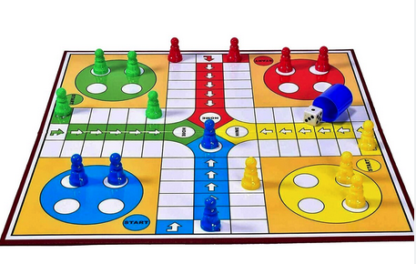
Foundation Models
(2018-present)
NLP popularized
Foundation Models
Foundation Model: Around 2018, represents one more shift of general AI paradigm. Mainly the area of Natural language Processing (NLP) witnessed this seismic shift; however these change is applicable to Computer Vision and other areas of AI. Let’s explain it in terms of emergence and homogenization
Emergence: result from the scale. surprising emergence of functionality that was neither the AI system specifically trained for nor anticipated to arise
GPT-3 with 175 billion parameters can be adapted to a downstream task simply simply simply providing it with a prompt (description of the task)
For example, you could ask GPT-3 to generate Python code for building a board game LUDU with graphical visualization. While GPT-3 may not have been specifically trained for this task, as long as you provide the correct logic and clear expectations for the visualization, it can generate code snippets with a surprising degree of accuracy. Here the function of LUDU emerges automatically
Homogenization:
a single model such as BERT/RoBERTa/GPT can now solve a wide range of applications
Besides homogenization of approaches, we observe homogenization across multiple subfields (such NLP, Computer Vision) in the form of multimodal models: foundation models trained jointly on images and textual data
…
You don’t have to explicitly tell the function (translate, rephrase, paraphrase, question-answer); it will emerge from the model
Homogenization is the
consolidation of extremely large models
On the Opportunities and Risks of Foundation Models. Bommasani, R et al. 2021
CS 195: Computer Vision (Dr Alimoor Reza)

Slide 23
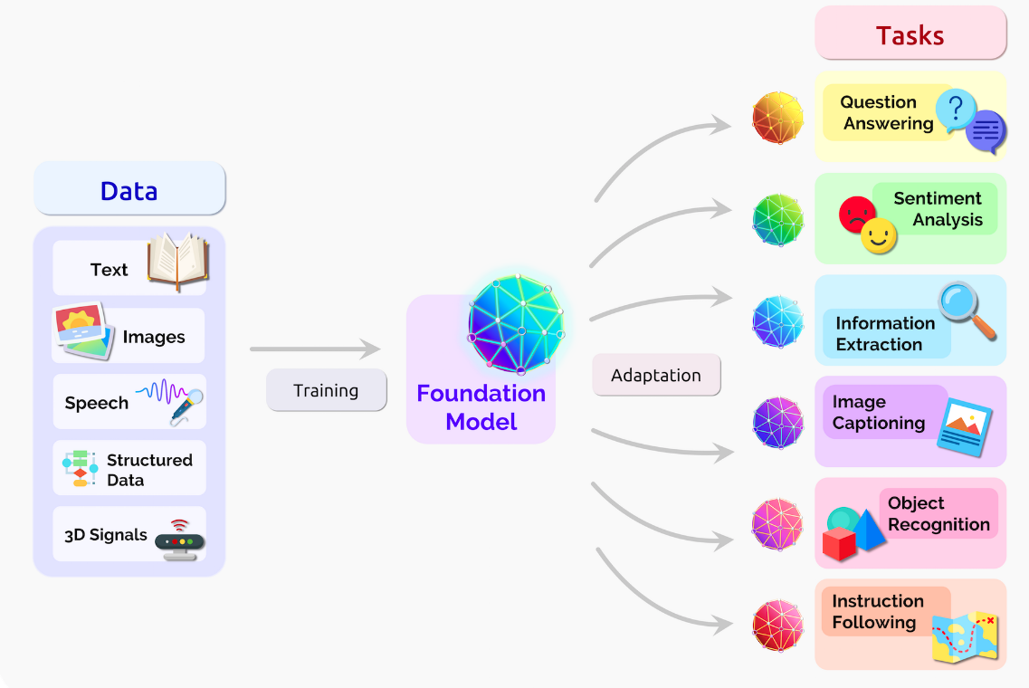
Foundation Models
(2018-present)
NLP popularized
Foundation Models
Foundation Model: Around 2018, represents one more shift of general AI paradigm. Foundation model is any model that is trained on broad data (generally using self-supervision + very large scale) that can be adapted (eg, fine-tuned) to a wide range of downstream tasks
BERT, GPT, CLIP
Cons: any flaws in the
foundation model are blindly
inherited by all the adapted
models
On the Opportunities and Risks of Foundation Models. Bommasani, R et al. 2021
CS 195: Computer Vision (Dr Alimoor Reza)

Slide 24
Segment Anything (SAM)
Segment Anything (SAM) is a foundation model for segmentation
It can segment unfamiliar objects and never-seen-before image without the need for additional need for training
zero-shot generalization property
Segment Anything - arxiv'23
CS 195: Computer Vision (Dr Alimoor Reza)

Slide 25
Segment Anything (SAM)
Segment Anything (SAM) is designed to be efficient enough to power its data engine. Model is decoupled into two submodules:
OPTIONAL
a one-time image encoder and
a lightweight mask decoder (that can run in a web-browser in just a few milliseconds per prompt)
SAM is trained on more than 1.1 billion segmentation masks collected on 11 million images
authors used SAM and data to interactively annotate images and update the model. This cycle was repeated many times over to improve both the model and the dataset
Segment Anything - arxiv'23
CS 195: Computer Vision (Dr Alimoor Reza)

Slide 26
Segment Anything (SAM)
Segment Anything (SAM) can also segment images based on a variety of input prompts
Segment based on prompt with interactive points and boxes
Generate multiple valid masks for ambiguous prompts
Segment Anything - arxiv'23
CS 195: Computer Vision (Dr Alimoor Reza)

Slide 27
Segment Anything (SAM)
Segment Anything (SAM) can also segment images based on a variety of input prompts
Cons: it may not work for
a uncommon object such
as sea-lion which remains
In underwater environment
Bounding box prompts from an object detector can enable text-to-object segmentation (may work for popular objects)
Segment Anything - arxiv'23
CS 195: Computer Vision (Dr Alimoor Reza)

Slide 28
Group Activity#1: Try Segment Anything Demo
Try zero-shot generalization capability
Try to segment images based on a variety of input prompts
https://segment-anything.com/demo#
CS 195: Computer Vision (Dr Alimoor Reza)

Slide 29
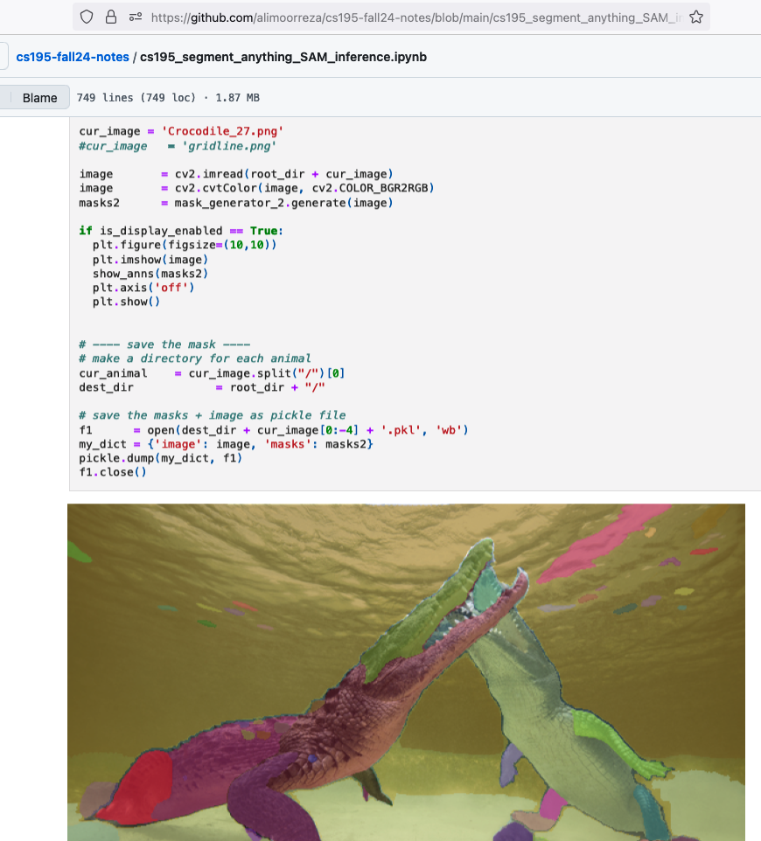
Group Activity#2: Try Segment Anything Demo
Try zero-shot generalization capability using PyTorch code
https://github.com/alimoorreza/cs195-fall24-notes/blob/main/cs195_segment_anything_SAM_inference.ipynb
CS 195: Computer Vision (Dr Alimoor Reza)

