Slide 1


CS167: Machine Learning
Convolutional Neural Network (CNN)
Wednesday, April 22nd, 2026
CS143: Artificial Intelligence
CS 167: Machine Learning (Dr Alimoor Reza)

Slide 2
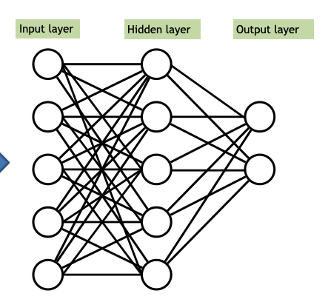
What’s Next?
A multilayer perceptron (MLP) is the simplest type of neural network. It consists of perceptrons (aka nodes, neurons) arranged in layers
…
…
…
A multilayer perceptron (MLP) is just the tip of the iceberg; plenty of other neural network variants exist.
CS 167: Machine Learning (Dr Alimoor Reza)

Slide 3
Today’s Agenda
Convolutional Neural Network (CNN): another type of neural network
Convolution operation
Nonlinearity
Pooling operation
CNN: convolutional layer + nonlinearity + pooling layer
CS 167: Machine Learning (Dr Alimoor Reza)

Slide 4
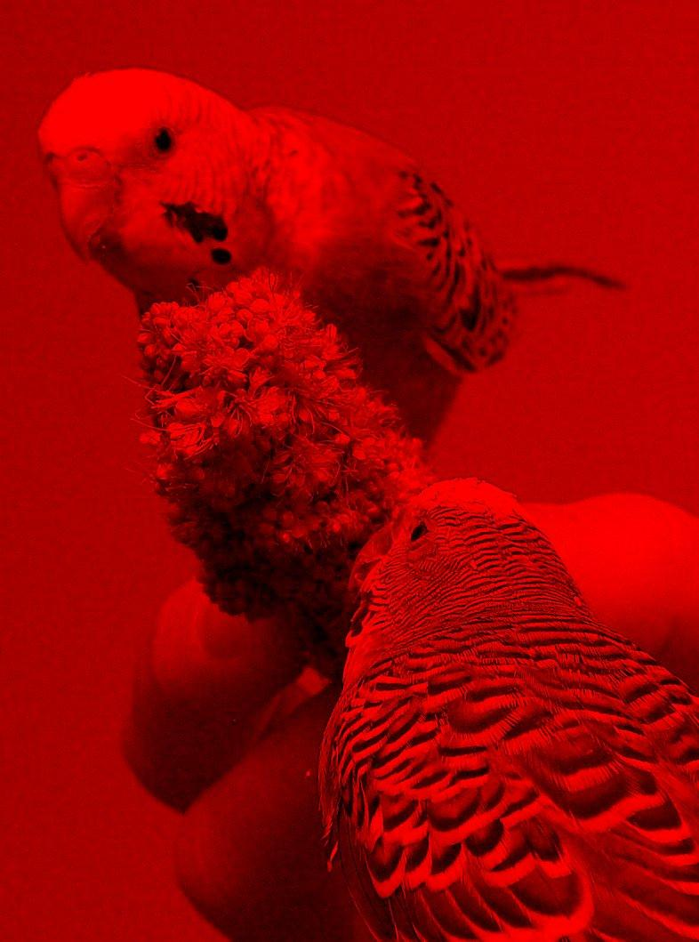
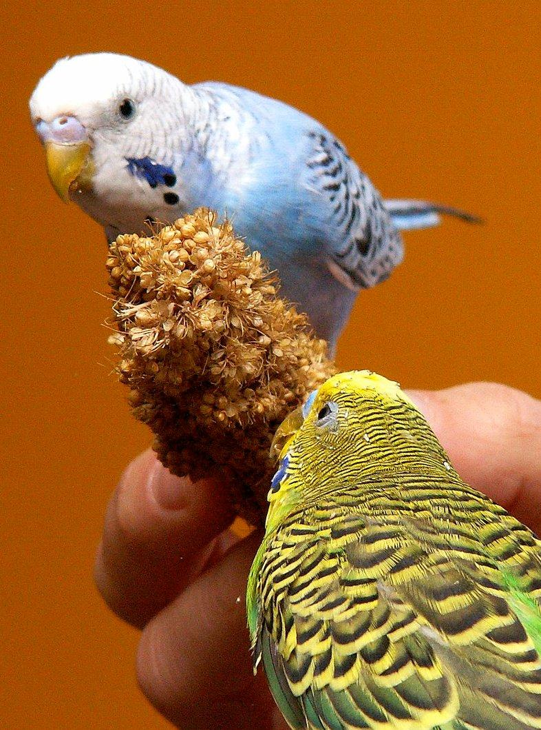
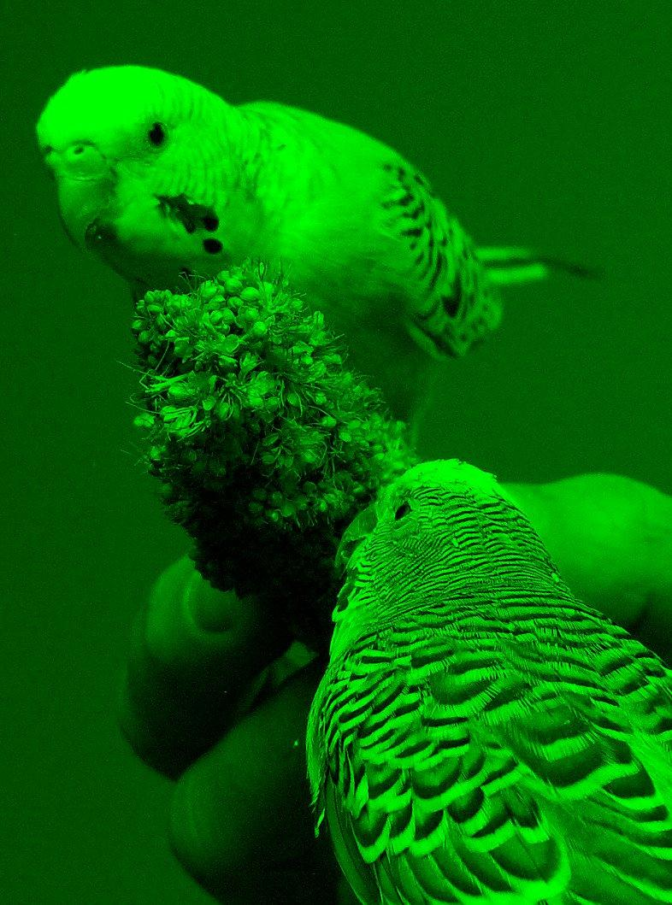
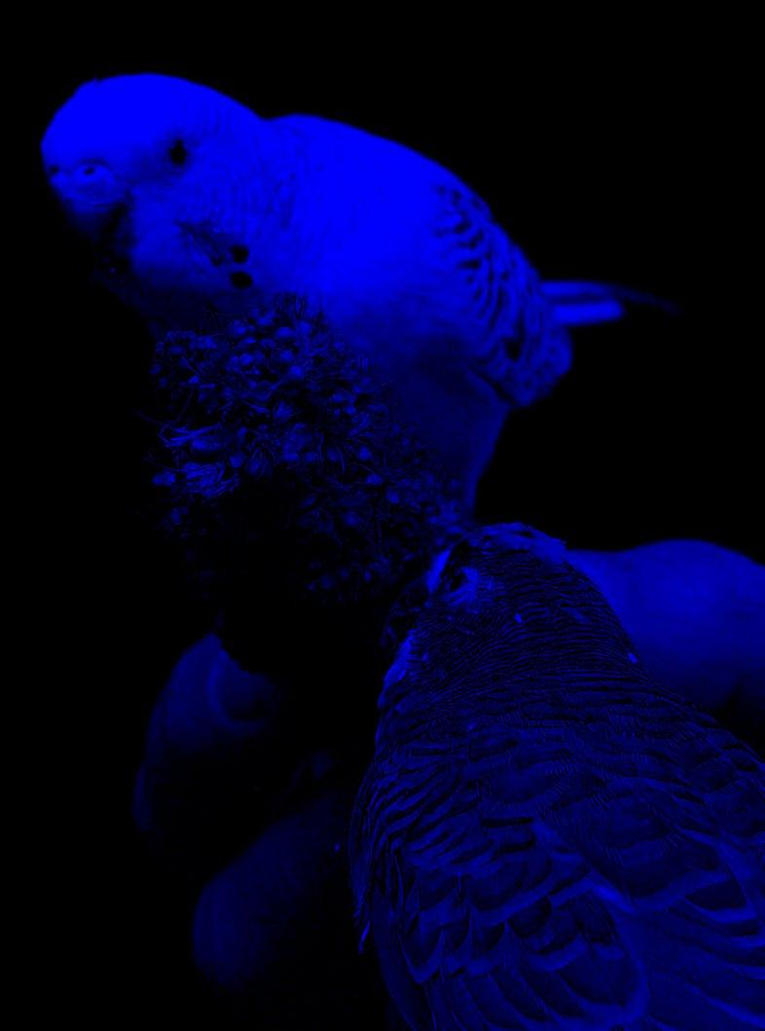
Convolutional Neural Network (CNN)
A convolutional neural network that applies convolutional filters on grid-like input such as a image
Red channel
Image data is represented as a two-dimensional grid of pixels, either grayscale (monochromatic) or color (RBG)
  each pixel corresponds to one or multiple numeric values: if it's grayscale, it is one number, if it's color, it corresponds to 3 numbers (a red, a green and a blue value)
Green channel
Color image
Blue channel
CS 167: Machine Learning (Dr Alimoor Reza)

Slide 5
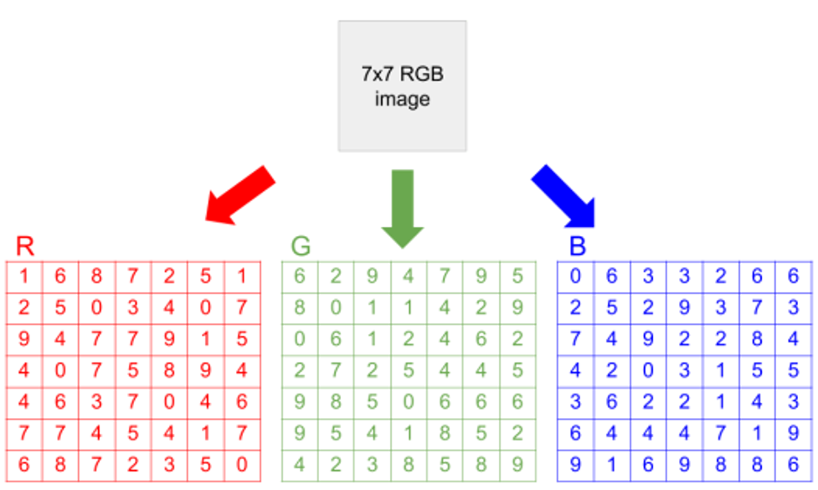
Convolutional Neural Network (CNN)
A convolutional neural network that applies convolutional filters on grid-like input such as a image
CS 167: Machine Learning (Dr Alimoor Reza)

Slide 6
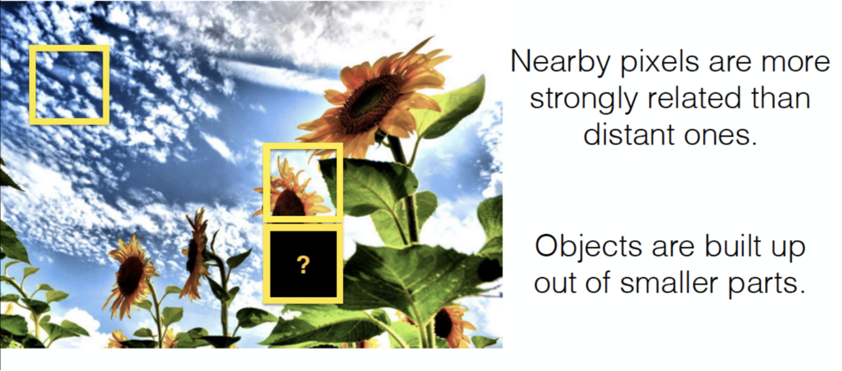
Convolutional Neural Network (CNN)
A convolutional neural network that applies convolutional filters on grid-like input such as a image
In order to capture the local dependence of images, we use convolutional filters. A convolutional filter, aka kernel:
  is smaller than the input data (usually 3x3 or 5x5 or 7x7)
  uses dot product multiplication between a piece of the input that is the size of the filter and the filter
  scans over the image from the upper left to the bottom right
CS 167: Machine Learning (Dr Alimoor Reza)

Slide 7




Convolution Operation
What does a convolution operation do?
In an ideal convolution operation, a kernel is “flipped” (horizontally and vertically) and then it is applied through the image (from left to right, and top to bottom)
kernel of size
3x3 or 5x5
CS 167: Machine Learning (Dr Alimoor Reza)

Slide 8


Convolution Operation
What does a convolution operation do?
0 | 0 | 0 | 0 | 0 | 0 | 0 | 0 | 0 | 0
0 | 0 | 0 | 0 | 0 | 0 | 0 | 0 | 0 | 0
0 | 0 | 0 | 90 | 90 | 90 | 90 | 90 | 0 | 0
0 | 0 | 0 | 90 | 90 | 90 | 90 | 90 | 0 | 0
0 | 0 | 0 | 90 | 90 | 90 | 90 | 90 | 0 | 0
0 | 0 | 0 | 90 | 0 | 90 | 90 | 90 | 0 | 0
0 | 0 | 0 | 90 | 90 | 90 | 90 | 90 | 0 | 0
0 | 0 | 0 | 0 | 0 | 0 | 0 | 0 | 0 | 0
0 | 0 | 90 | 0 | 0 | 0 | 0 | 0 | 0 | 0
0 | 0 | 0 | 0 | 0 | 0 | 0 | 0 | 0 | 0
 | 0 | 10 | 20 | 30 | 30 | 30 | 20 | 10
 | 0 | 20 | 40 | 60 | 60 | 60 | 40 | 20
 | 0 | 30 | 60 | 90 | 90 | 90 | 60 | 30
 | 0 | 30 | 50 | 80 | 80 | 90 | 60 | 30
 | 0 | 30 | 50 | 80 | 80 | 90 | 60 | 30
 | 0 | 20 | 30 | 50 | 50 | 60 | 40 | 20
 | 10 | 20 | 30 | 30 | 30 | 30 | 20 | 10
 | 10 | 10 | 10 | 0 | 0 | 0 | 0 | 0
*
=
1/9 | 1/9 | 1/9
1/9 | 1/9 | 1/9
1/9 | 1/9 | 1/9
kernel of size 3x3 units
image of 10x10 units
convolved result of 10x10 units
CS 167: Machine Learning (Dr Alimoor Reza)

Slide 9
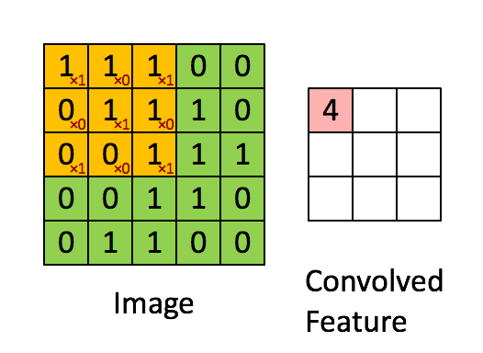
Convolution Operation
What does a convolution operation do?
convolution operation can be achieved with a series of dot products between portions of input feature map and a convolution filter (kernel) weights
1*1 + 1*0 + 1*1 +
0*0 + 1*1 + 1*0 +
0*1 + 0*0 + 1*1 = 4
Another visualization shows a yellow convolution filter applied to a green image, resulting in the convolved feature
CS 167: Machine Learning (Dr Alimoor Reza)

Slide 10
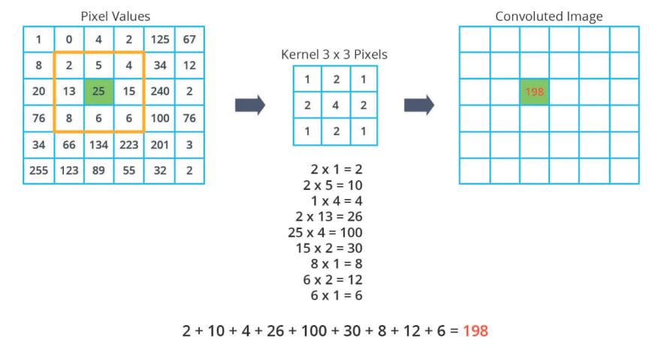
Convolution Operation
What does a convolution operation do?
convolution operation can be achieved with a series of dot products between portions of input feature map and a convolution filter (kernel) weights
CS 167: Machine Learning (Dr Alimoor Reza)

Slide 11
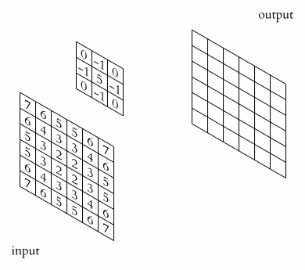
Convolution Operation Animation!
What does a convolution operation do?
convolution operation can be achieved with a series of dot products between portions of input feature map and a convolution filter (kernel) weights
Another visualization shows a convolution filter applied to an image, resulting in the convolved feature
CS 167: Machine Learning (Dr Alimoor Reza)

Slide 12
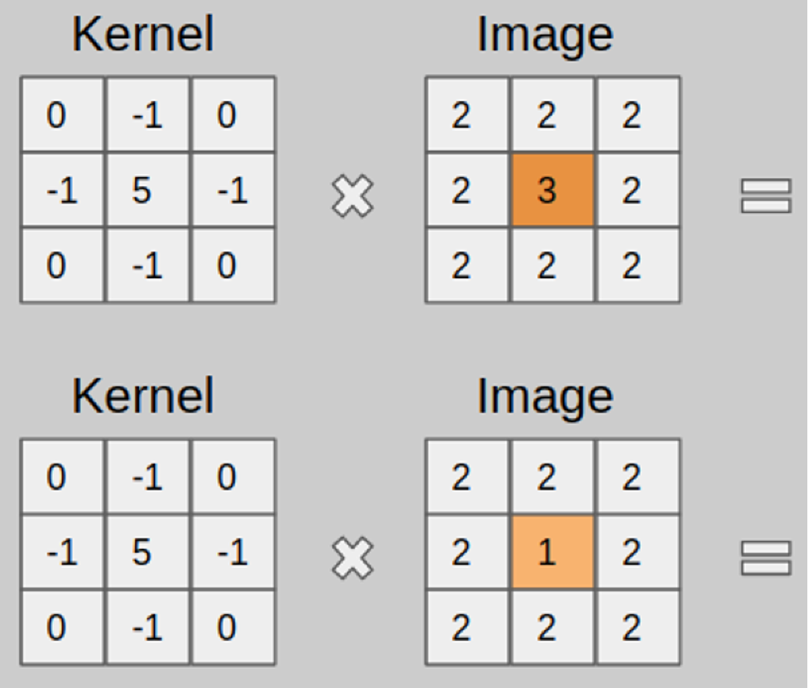
Group Exercise
find the result of the convolution operation below
*
*
CS 167: Machine Learning (Dr Alimoor Reza)

Slide 13
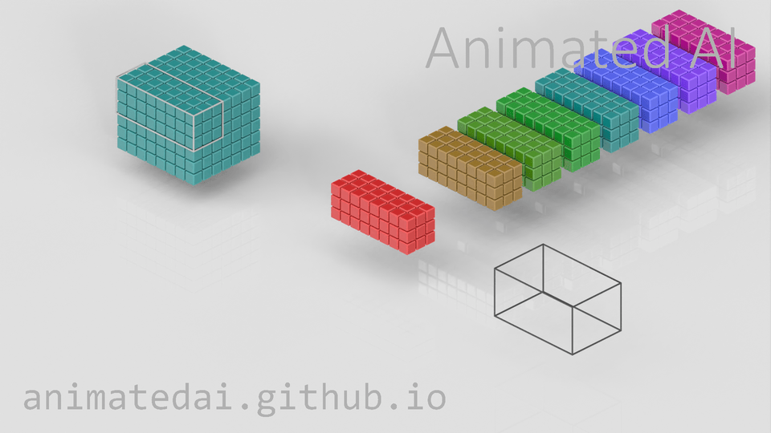
How to calculate the output volume size?
CS 167: Machine Learning (Dr Alimoor Reza)

Slide 14
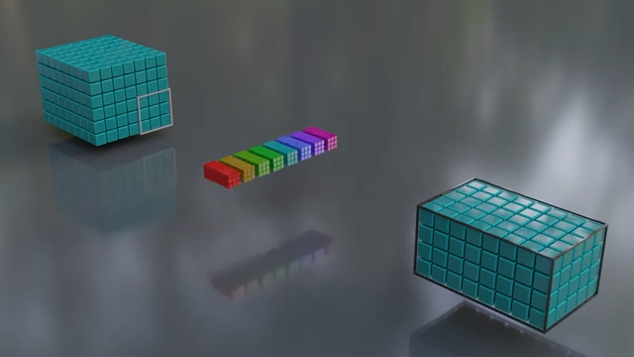
How to calculate the output volume size?
https://www.youtube.com/watch?v=w4kNHKcBGzA&t=210s
CS 167: Machine Learning (Dr Alimoor Reza)

Slide 15
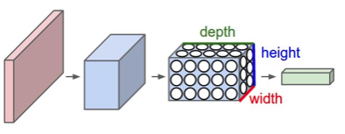
Convolutional Neural Network (CNN)
A convolutional neural network (CNN) is a neural network with specialized connectivity structure
convolutional filters
Every layer of a CNN transforms the input volume to an output volume of neuron activations. The red input layer holds the image, so its width and height would be the dimensions of the image, and the depth would be 3 (Red, Green, Blue channels)
CS 167: Machine Learning (Dr Alimoor Reza)

Slide 16
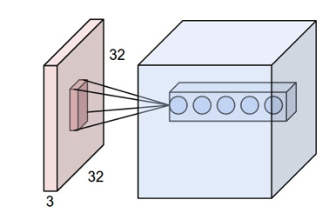
Convolutional Neural Network (CNN)
convolutional kernel of size FxF units
input feature map
output feature map
input volume
output volume
Weights correspond to the filter (kernel) values
Convolutional neural network can learn their own filters!
  We do not need to provide the values inside the kernel
CS 167: Machine Learning (Dr Alimoor Reza)

Slide 17
CNN: How to calculate the output volume size?
convolutional kernel of size FxF units
input feature map
output feature map
Output volume height=?
Output volume width=?
Output volume
depth=?
CS 167: Machine Learning (Dr Alimoor Reza)

Slide 18
CNN: How to calculate the output volume size?
An input volume has size (WxWx3), eg, (227, 227, 3)
Filter size/receptive field is (FxF), eg, (11x11)
Spatial Stride S, eg, S=4
Padding size P, eg, P=0
Number of filters K, eg, K=96
convolutional kernel of size FxF units
input volume
output volume
output
volume
height
Size of the output volume width and output volume height as a function of W, F, S,and P as follows:
output
volume
width
output
volume
depth
(W - F + 2P)
(227 - 11 + 2*0)
output volume width/height
_________
_____________
+
1
=
+
1
=
54+1
=
55
=
S
4
CS 167: Machine Learning (Dr Alimoor Reza)

Slide 19
How to calculate the output volume size?
An input volume has size (W1 x H1 x D1)
  Filter size/receptive field is (FxF)
  Spatial stride size S
  Padding size P
  Number of filters K
convolutional kernel of size FxF units
input volume
output volume
Spatial sizes of the output volume (W2 x H2 x D2)
(W1 - F + 2P)
output
volume
height
W2
=
_________
+
1
S
(H1 - F + 2P)
output
volume
width
H2
=
_________
S
+
1
D2
=
K
Number of filter weight parameters = (F x F x D1) x K
Number of bias parameters = K
CS 167: Machine Learning (Dr Alimoor Reza)

Slide 20
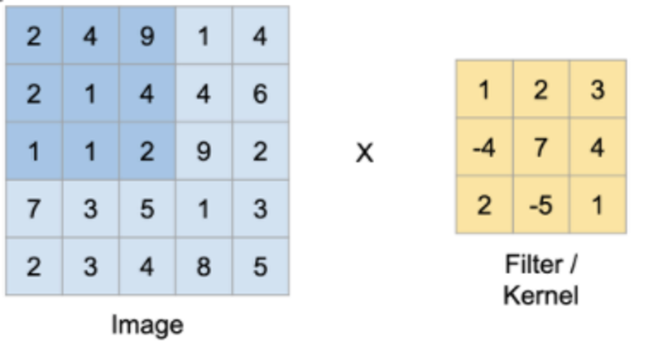
Group Exercise
What will the size of the output of the following convolution be?
  (5x5x1) * (3x3)
*
CS 167: Machine Learning (Dr Alimoor Reza)

Slide 21
Today’s Agenda
Convolutional Neural Network (CNN): another type of neural network
Convolution operation
Nonlinearity
Pooling operation
CNN: convolutional layer + nonlinearity + pooling layer
CS 167: Machine Learning (Dr Alimoor Reza)

Slide 22
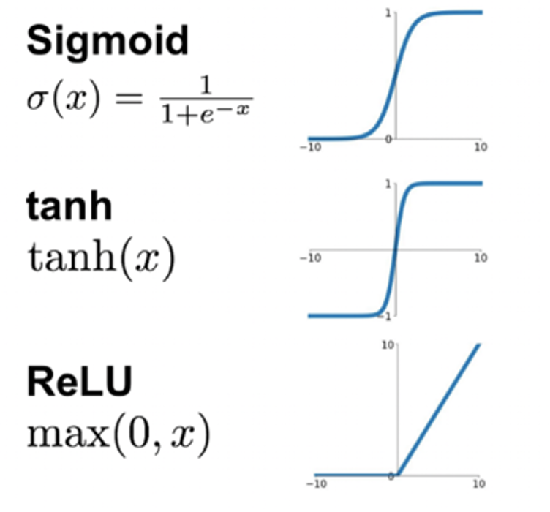
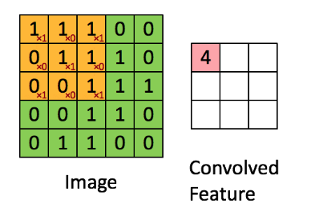
Nonlinear Function
Just like an MLP, each convolutional output goes through a non-linear function such as Sigmoid, Tanh, or Rectified Linear Unit (ReLU)
$$convolution=1*1+1*0+1*1+0*0+1*1+1*0+0*1+0*0+1*1=4$$
$$Sigmoid(4)=\frac{1}{1+exp(-4)}=0.98$$
0.98
Sigmoid
CS 167: Machine Learning (Dr Alimoor Reza)

Slide 23
Today’s Agenda
Deep Learning
Convolutional Neural Network (CNN)
Convolution operation
Nonlinearity
Pooling operation
CNN: convolutional layer + nonlinearity + pooling layer
CS 167: Machine Learning (Dr Alimoor Reza)

Slide 24
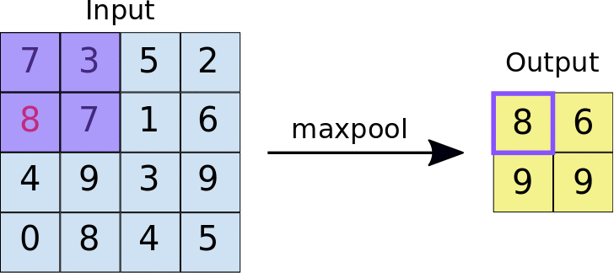
Pooling Operation
Image data can get computationally inefficient, really quickly. To avoid this, we often toss in a layer that helps us to summarize and downsample the data
In classical CNN, we find another useful operation called pooling operation
A common pooling operation is max pooling, and its goal is to locally summarize the convolution. It performs something like a convolution, but rather than taking the dot product, it takes the maximum element in the filter area
CS 167: Machine Learning (Dr Alimoor Reza)

Slide 25
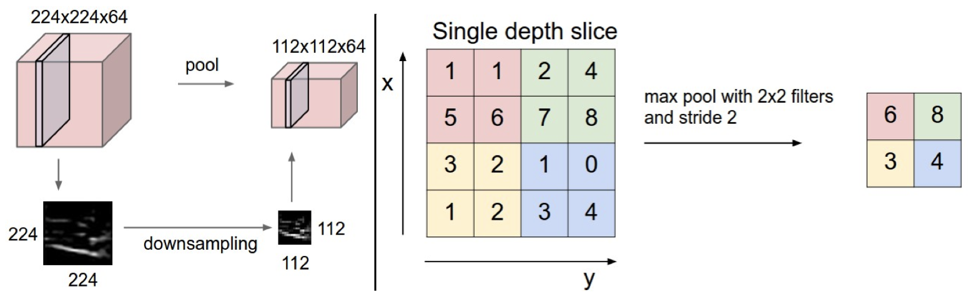
Pooling Operation
Pooling operation downsamples the volume spatially, independently in each depth slice of the input volume
Besides max pooling, other pooling operations include: sum pooling, average pooling
CS 167: Machine Learning (Dr Alimoor Reza)

Slide 26
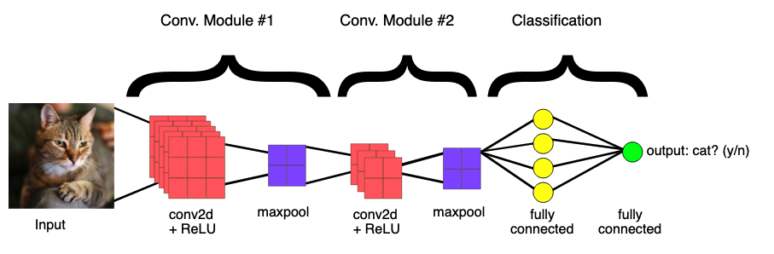
CNN: A Composition of Convolutional Layers
We've talked about image data, convolutions, nonlinearity, max pooling, and how they are related to some computer vision tasks. Let's connect the dots
  input is an image (in this case a color image, so 3 channels—red, green, and blue)
  there are several filters, not just one.
  Conv2D layers with ReLU are often followed by maxpool
  towards the end of the model, we switch to fully connected (Dense) layer
  We have as many output nodes as we have classes to predict
Reference
CS 167: Machine Learning (Dr Alimoor Reza)

