Slide 1
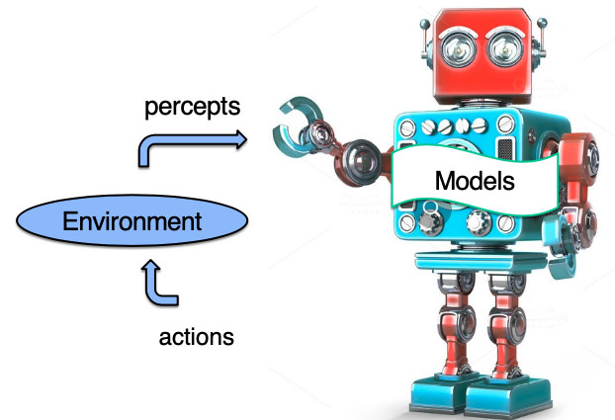


CS143: Artificial Intelligence
Introduction to Reinforcement Learning (RL)
CS143: Artificial Intelligence | Dr Alimoor Reza (Drake University)

Slide 2
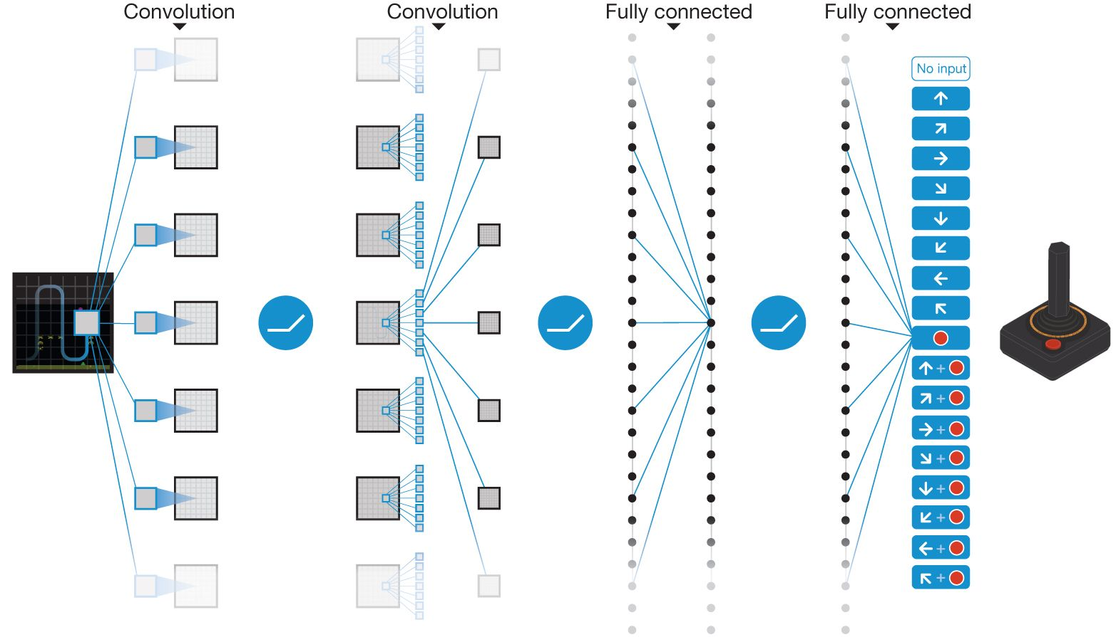
Reinforcement Learning in Action
We observing a rise in general-purpose solutions
Google DeepMind wins Atari Video Games in 2015
Used Deep Q-Network (DQN) reinforcement learning method
Playing Atari with Deep Reinforcement Learning - NIPS'13 workshop
CS143: Artificial Intelligence | Dr Alimoor Reza (Drake University)
Deep Mind playing Atari game
AlphaGo vs Lee Sedol

Slide 3
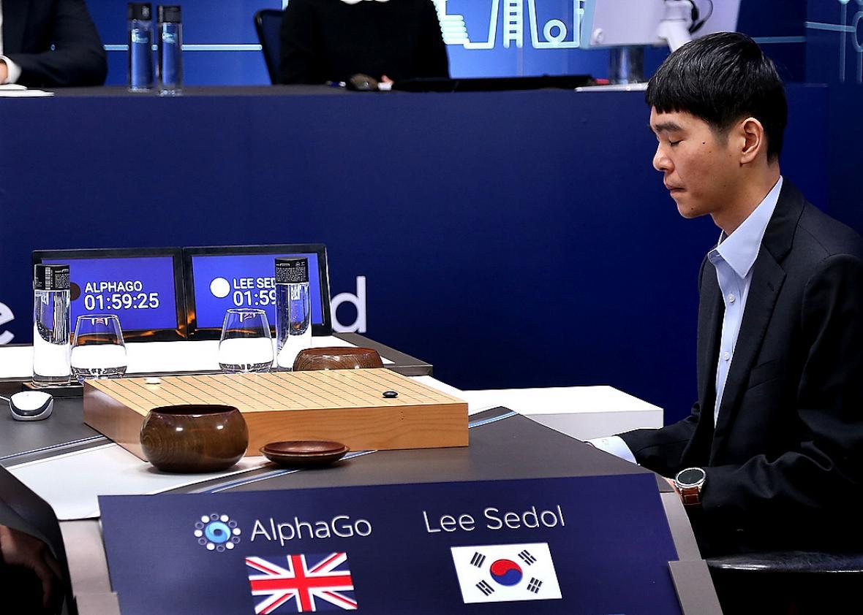
Reinforcement Learning in Action
We observing a rise in general-purpose solutions
Google Deepmind AlphaGo beats world best human Go player Lee Sedol in 2016
Used Monte Carlo Tree Search (MCTS) reinforcement learning method
AlphaGo: Mastering the game of Go with deep neural networks and tree search - Nature'16
CS143: Artificial Intelligence | Dr Alimoor Reza (Drake University)
Deep Mind playing Atari game
AlphaGo vs Lee Sedol

Slide 4
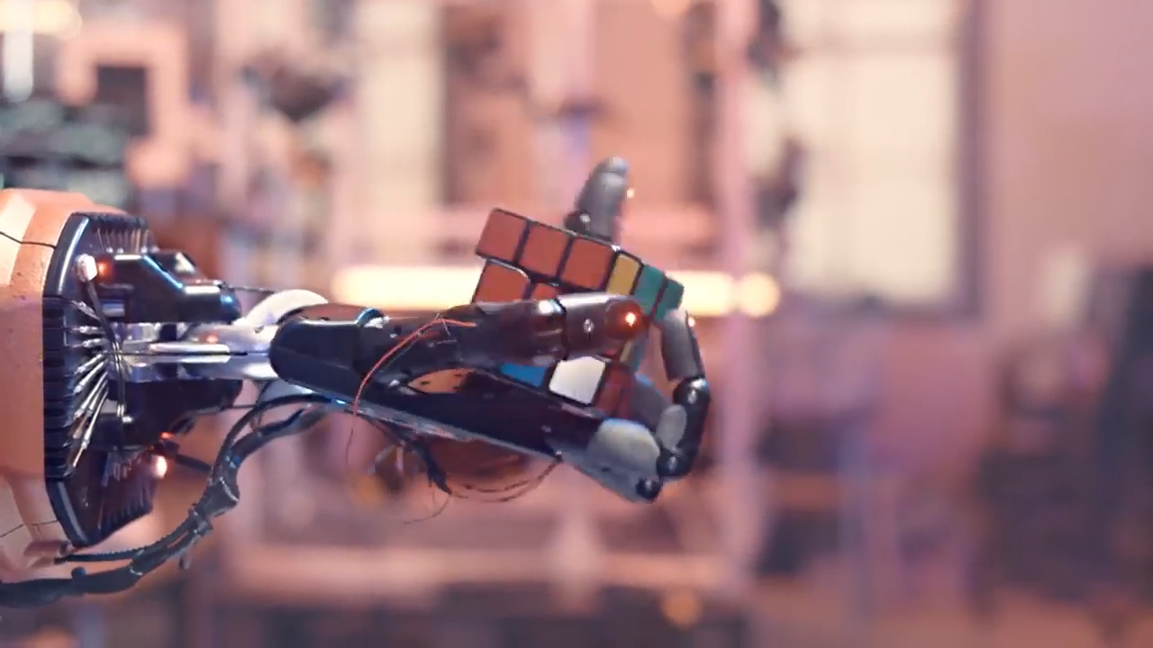
Reinforcement Learning in Action
We observing a rise in general-purpose solutions:
OpenAI Rubik’s Cube Solver in 2019
Reference: https://openai.com/blog/solving-rubiks-cube
CS143: Artificial Intelligence | Dr Alimoor Reza (Drake University)

Slide 5
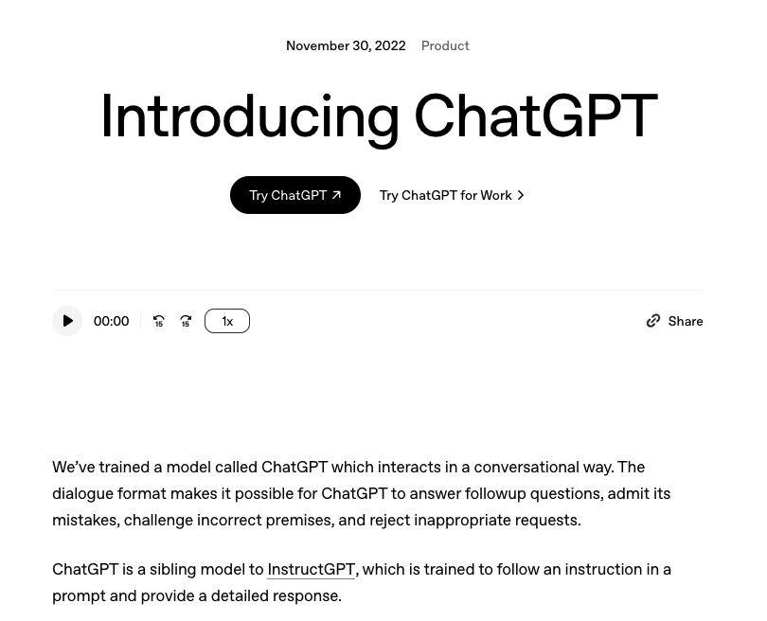
Reinforcement Learning in Action
We observing a rise in general-purpose solutions:
OpenAI ChatGPT in 2022
Reference: https://openai.com/index/chatgpt
CS143: Artificial Intelligence | Dr Alimoor Reza (Drake University)

Slide 6
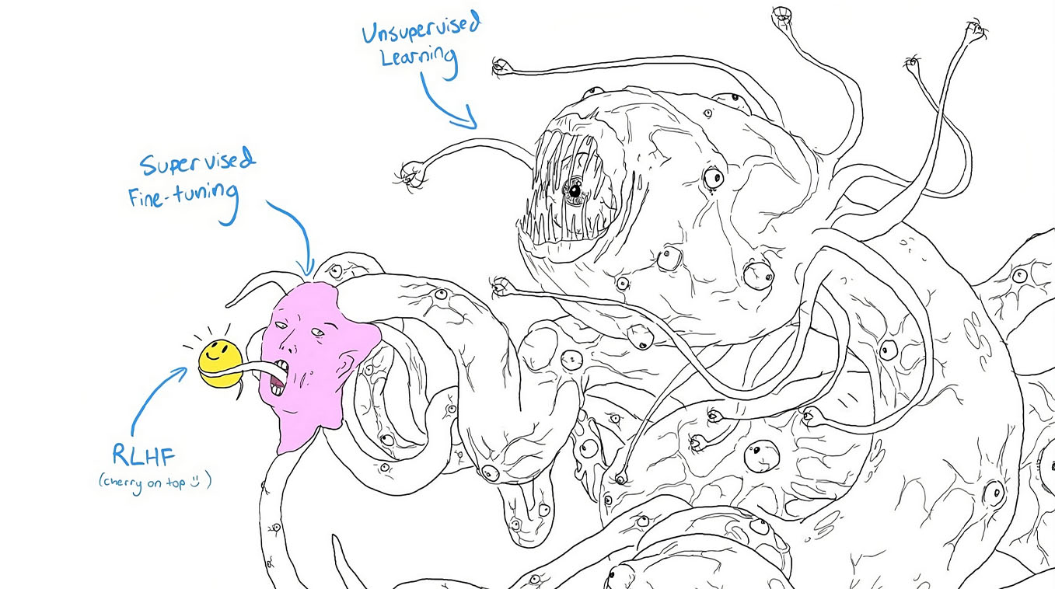
ChatGPT
https://knowyourmeme.com/memes/shoggoth-with-smiley-face-artificial-intelligence
CS143: Artificial Intelligence | Dr Alimoor Reza (Drake University)

Slide 7
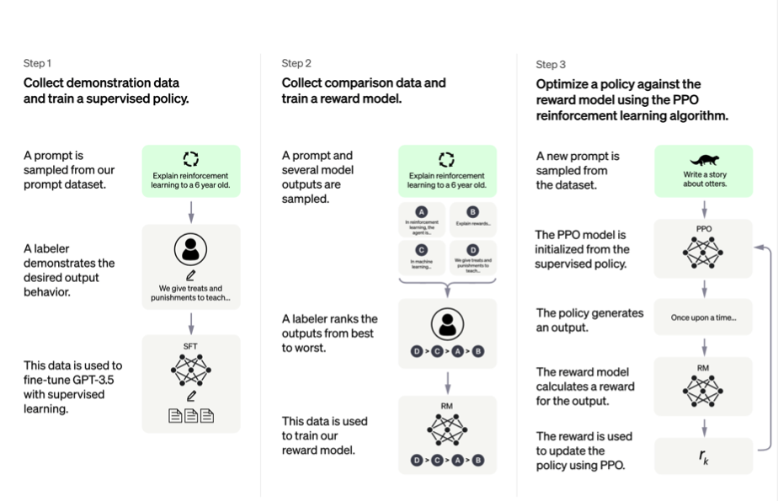
ChatGPT used Reinforcement Learning
Supervised Learning (with cross-entropy loss)
Supervised Learning (with ranking loss)
Reinforcement Learning with PPO method
https://openai.com/blog/chatgpt/
CS143: Artificial Intelligence | Dr Alimoor Reza (Drake University)

Slide 8
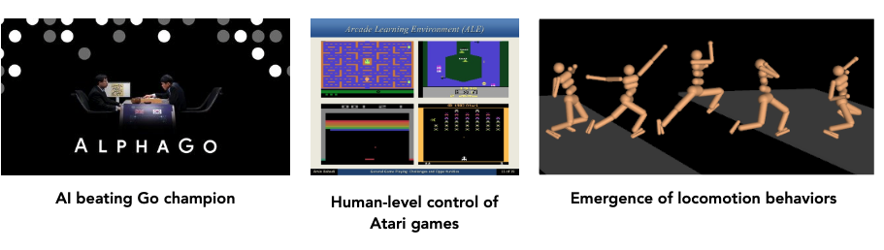
Reinforcement Learning
We observing a rise in general-purpose solutions
CS143: Artificial Intelligence | Dr Alimoor Reza (Drake University)

Slide 9
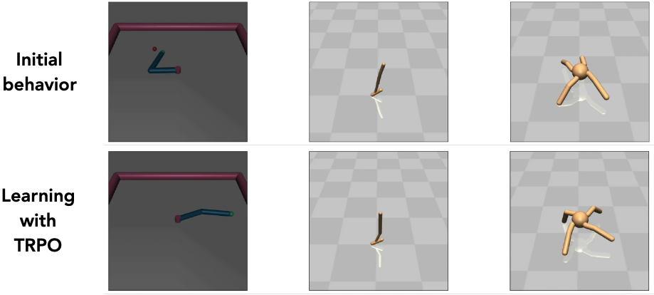
Reinforcement Learning
Deep RL agents show excellent general learning capabilities in virtual worlds
CS143: Artificial Intelligence

Slide 10
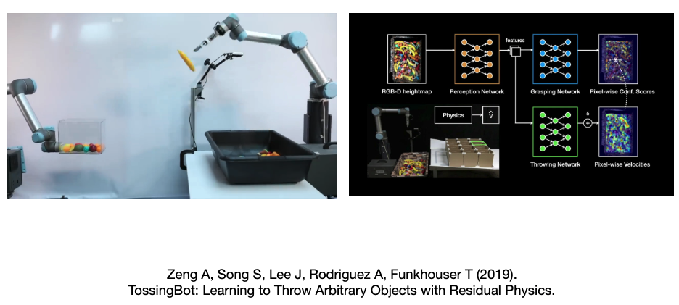
Reinforcement Learning
Hybrid approaches are becoming popular in robotics
CS143: Artificial Intelligence | Dr Alimoor Reza (Drake University)

Slide 11
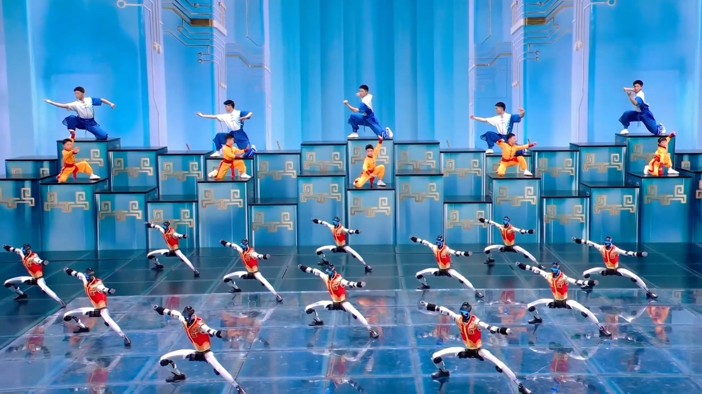
Reinforcement Learning
Latest update: Chinese New Year celebration last month (in February2026) — most likely a carefully engineered systems: pre-programmed + partially autonomous + human-supervised)
CS143: Artificial Intelligence | Dr Alimoor Reza (Drake University)

Slide 12
Successful Application of Reinforcement Learning
Atari Breakout: https://www.youtube.com/watch?v=V1eYniJ0Rnk
Mar I/O, part 1: https://www.youtube.com/watch?v=qv6UVOQ0F44
Mar I/O, part 2: https://www.youtube.com/watch?v=L4KBBAwF_bE
CS143: Artificial Intelligence | Dr Alimoor Reza (Drake University)

Slide 13
Reinforcement Learning
RL: learning to make good decisions under uncertainty with the following components:
Optimization: goal is to find an optimal way to make decisions
Eg, finding minimum distance route between two cities given network of roads
Delayed consequences: decisions now can impact things much later...
Eg, saving for retirement
Exploration: learning about the world by making decisions
Eg, learn to ride a bike by trying (and failing)
Generalization: learning a policy — a mapping from past experience to action
Eg, deepMind’s Atari Solution
CS143: Artificial Intelligence | Dr Alimoor Reza (Drake University)

Slide 14
Reinforcement Learning
Reinforcement learning is learning what to do—how to map situations to actions—with the aim of maximizing a numerical reward signal
The learner is not told which actions to take, but instead must discover which actions yield the most reward by trying them
No heuristics are supplied; the learner starts as a blank slate
CS143: Artificial Intelligence | Dr Alimoor Reza (Drake University)

Slide 15
RL: difference with other machine learning paradigm
By interacting with his environment through trial and error, the learner/agent understands that it needs to obtain +ve reward (by doing certain actions) but also need to to avoid -ve reward (by not taking certain actions in certain scenarios)
These +ve and -ve rewards are just environment’s feedback to the learner
The agent/learner is not told which actions to take; without any explicit supervision (on every step), it will get better and better by interacting with the environment through trial and error
Biological species (humans, animals, and microorganisms) learn through interaction; accordingly, RL is a computational approach that learns from actions.
CS143: Artificial Intelligence | Dr Alimoor Reza (Drake University)

Slide 16
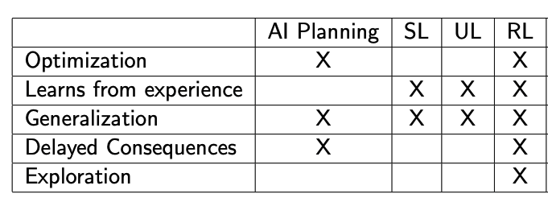
Reinforcement Learning
SL = Supervised learning; UL = Unsupervised learning; RL = Reinforcement Learning
CS143: Artificial Intelligence | Dr Alimoor Reza (Drake University)

Slide 17
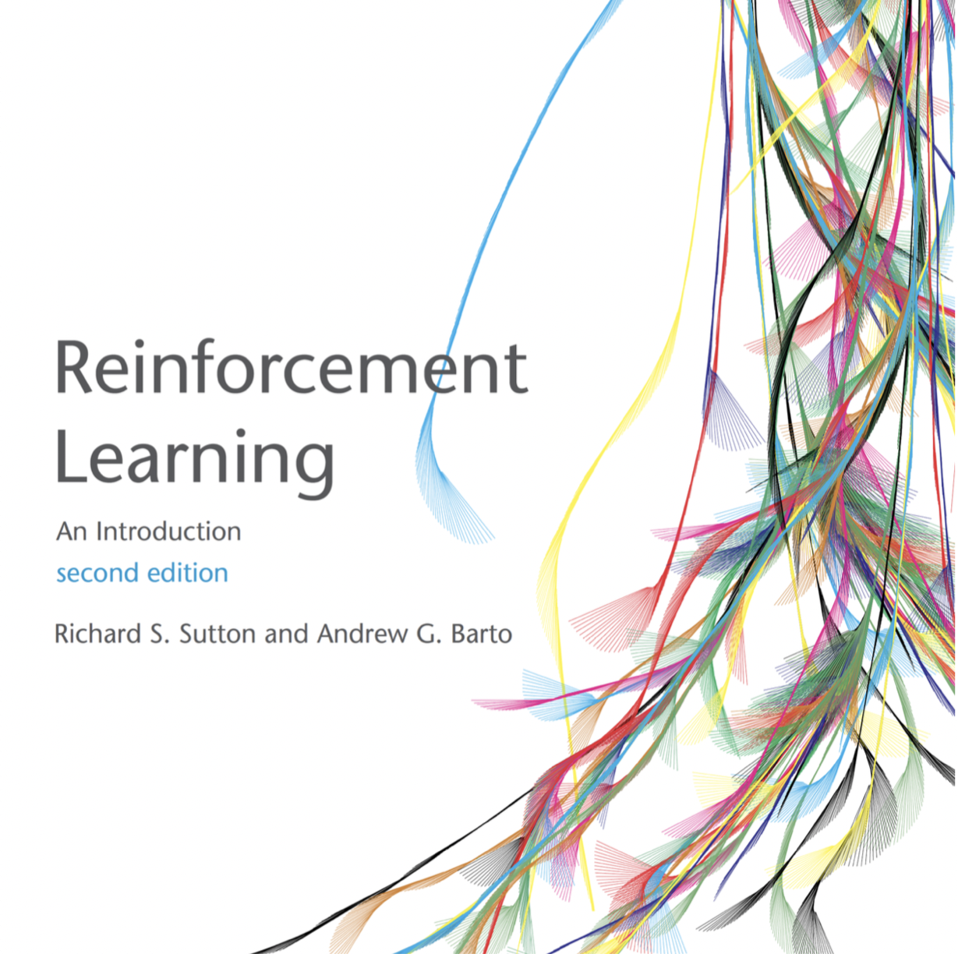
Textbook: Reinforcement Learning
http://incompleteideas.net/book/the-book-2nd.html
Reading activity: Read pages 1-6 of Reinforcement Learning by Sutton and Barto
Uploaded the pages on my course website + on BB
CS143: Artificial Intelligence | Dr Alimoor Reza (Drake University)

