Slide 1
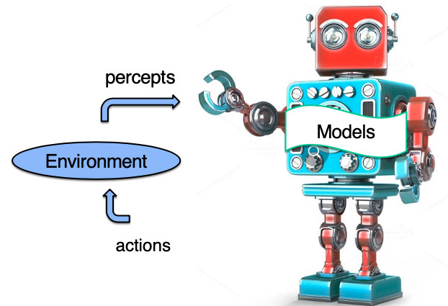


CS143: Artificial Intelligence
Introduction to Reinforcement Learning (RL)
CS143: Artificial Intelligence | Dr Alimoor Reza (Drake University)

Slide 2
Reinforcement Learning
Machine Learning is the study of algorithms that improve from experience and the use of data.
    Supervised Learning: Inferring a function from labeled training data. The training data consist of a set of training examples.
    Unsupervised Learning: Draw inferences from datasets consisting of input data without labeled responses to unearth hidden structure in the data.
    Reinforcement learning is the third paradigm of teaching machines with different form of labels (a.k.a rewards)
CS143: Artificial Intelligence | Dr Alimoor Reza (Drake University)

Slide 3
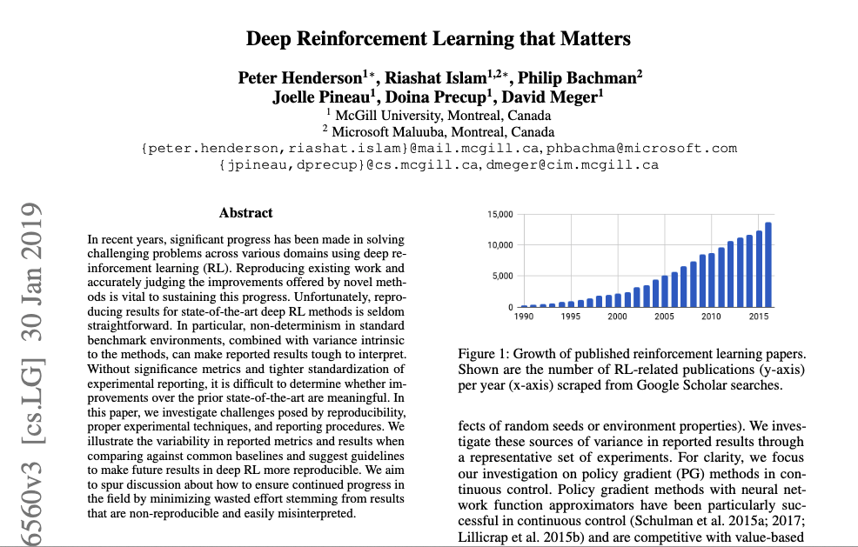
Reinforcement Learning
Quite recently, there is a huge increase in interest in Reinforcement Learning
https://arxiv.org/pdf/1709.06560.pdf
CS143: Artificial Intelligence | Dr Alimoor Reza (Drake University)

Slide 4
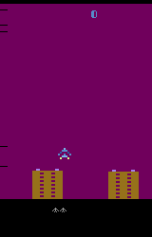
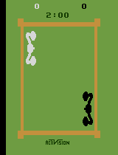
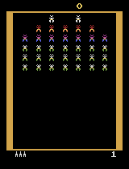
Reinforcement Learning in Action
We observing a rise in general-purpose solutions
Google DeepMind wins Atari Video Games in 2015
Atari Video Games examples: AirRaid, Boxing, Galaxian
AirRaid
Boxing
Galaxian
https://ale.farama.org/environments/complete_list/
CS143: Artificial Intelligence | Dr Alimoor Reza (Drake University)
Deep Mind playing Atari game
AlphaGo vs Lee Sedol

Slide 5
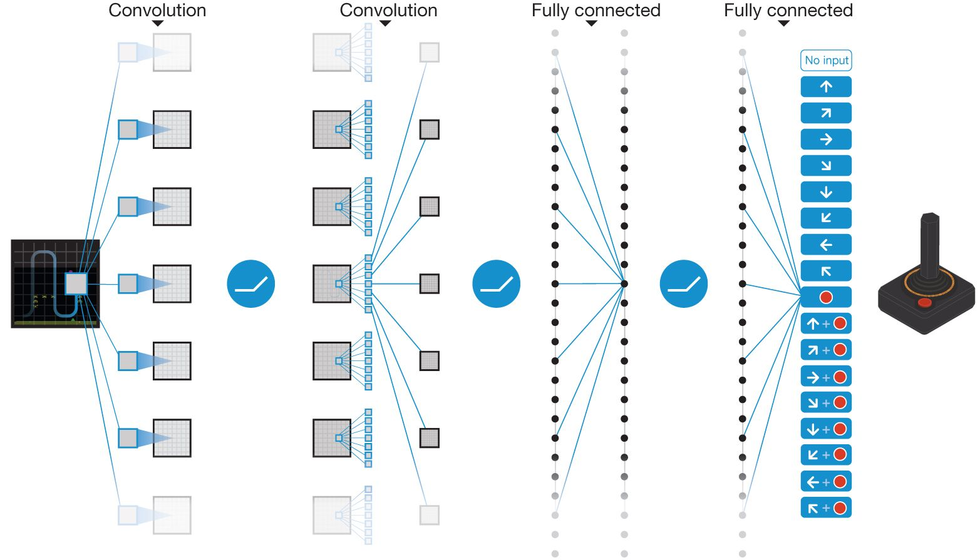
Reinforcement Learning in Action
We observing a rise in general-purpose solutions
Google DeepMind wins Atari Video Games in 2015
Used Deep Q-Network (DQN) reinforcement learning method
Playing Atari with Deep Reinforcement Learning - NIPS'13 workshop
CS143: Artificial Intelligence | Dr Alimoor Reza (Drake University)
Deep Mind playing Atari game
AlphaGo vs Lee Sedol

