Slide 1
Unsupervised Human Fatigue Expression Discovery via Time Series Chain
Frida Cantu, Kofi Nketia Ackaah-Gyasi, Li Zhang
University of Texas Rio Grande Valley
Adam Haroon
Iowa State University
William Carlyon, Md Alimoor Reza
Drake University
Notes:
Hello everyone. I am Frida Cantu, an undergraduate student at the University of Texas Rio Grande Valley. I am here to present our work on Unsupervised Human Fatigue Expression Discovery via Time Series Chain. This is a joint work in collaboration with Adam Haroon from Iowa State University along with Alimoor Reza and others from Drake University.

Slide 2
Motivation
Continuous fatigue monitoring is crucial for ensuring safety in professional settings amidst demanding work hours.
Limited data and lack of timely labels.
Complexity of fatigue as a psychological and physiological state.
Notes:
In today’s demanding work environments where long hours are common, we often find ourselves in the same sedentary position every day, staring at our computer with a slouch on our office chair as we draft reports, send emails, and read articles. Feeling ready and awake and the start of the day, it’s not uncommon to find ourselves tired and fatigued at the end of our long workday. Yet, the effects of fatigue go far beyond decreased productivity and exhaustion with the long term effects of this condition often resulting in serious health concerns such as spinal dysfunction, muscle fatigue, and joint degradation. And with the shift to remote working environments, these effects have only exacerbated. With the serious implications fatigue posses on the health and safety of working environments, the ability to reliably detect fatigue becomes paramount. Despite the importance of fatigue, however, detecting signs of fatigue is highly challenging in practice with the lack of data and timely labels for long term fatigue monitoring. This challenge is compounded by the complexity of fatigue itself as both a psychological and physiological state which we all subjectively experience, making fatigue difficult to generalize.

Slide 3
Contribution
Developed a novel unsupervised pipeline leveraging data from a single video source to identify evolving expressions for potential signs of human fatigue.
Demonstrated effectiveness of robust time series chain discovery as a as a low cost method for automatically identifying evolving behavior in video data streams.
Notes:
To tackle the challenge of fatigue detection, we propose an unsupervised pipeline leveraging data from a single video source to identify evolving precursors for potential signs of human fatigue using robust time series chain discovery. Our proposed framework initially extracts key landmark points such as the shoulder joints from the video streaming data and subsequently identifies the evolving behavior patterns using robust time series chain discovery to uncover precursors indicative of potential human fatigue. We demonstrate the efficacy of our framework in detecting signs and expressions of fatigue using video data collected from real-world fatigue scenarios.

Slide 4
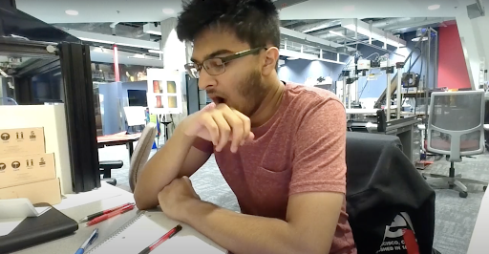
Time Series Chain
Effective high order time series primitives that represent a series of interconnected events over time.
We employ time series chains to capture temporal dependencies and variations in human facial and body expressions.
Working and Attentive
Yawning
Highly Fatigued
Figure: Evolution of fatigue captured by time series chain.
Notes:
Time series chains are effective high-order time series primitives that represent interconnected events over time. They allow us to identify ordered sets of subsequences within our data, capturing evolving trends and patterns. These chains are particularly useful for detecting temporal dependencies and variations in human facial and body expressions, enabling us to capture specific features and nuances that may not be apparent with individual data points.

Slide 5
Robust Time Series Chain Discovery
Utilize the Robust Time Series Chain Algorithm (TSC22) to detect evolving fatigue patterns in landmark time series data.
TSC22 employs the STUMP algorithm to compute LNN and INNS for critical node detection, then discovers chains by marking visited nodes and avoiding repeats, storing sub-chains for each discovered chain.
Apply chain ranking criteria, utilizing metrics like Effective Length (Leff) and Correlation Length (Lcorr) for prioritization of longer chains with similar consecutive subsequences to acquire the optimal chains from the all-chain set.
Notes:
Robust time series chain discovery is a method used to identify evolving trends within a dataset over time by finding similar time series chains related to specific events. In our case, we apply this algorithm to detect evolving fatigue patterns in landmark time series data. We use the ranking criteria within this algorithm to select the longest chains with the most similar consecutive subsequences, enabling us to acquire the optimal set of time series chains for our analysis.

Slide 6
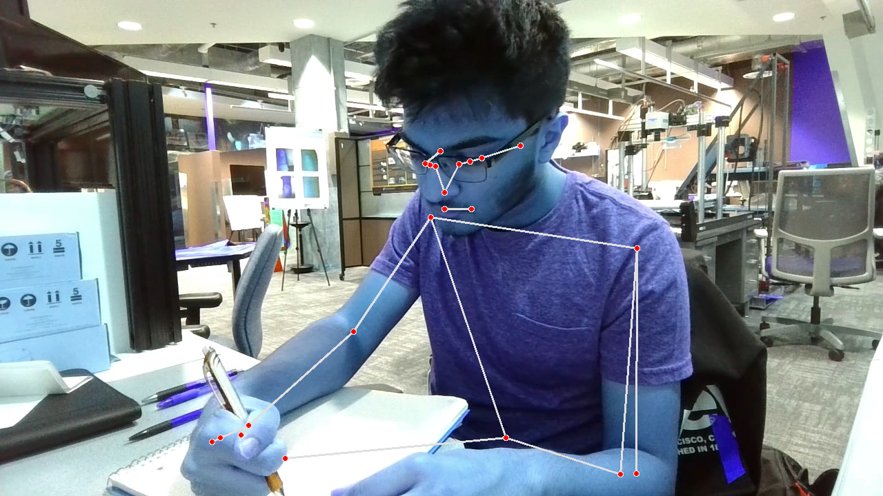
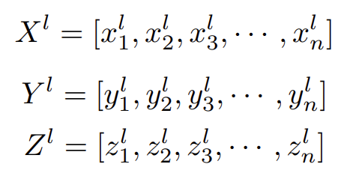
Pose Landmark Detection
Utilized the pose landmark detection model to identify 33 pose landmarks in each frame of the video.
Accumulated 2D spatial image coordinates X and Y and estimated depth coordinates Z of each landmark over the entire video to construct time series data for individual pose landmarks.
Constructed three time series (X, Y, Z) for each landmark, representing the evolution of spatial coordinates over time which were used as input to the robust time series chain discovery algorithm.
Creation of Three Time Series for Each Dimension
Landmark Detected
3D spatial information for l^{th} landmark in i^{th} frame
Notes:
We utilize the MediaPipe pose landmark detection model to acquire the landmark spatial data of particular points of interest. The MediaPipe pose landmark detection model abstracts the entire human body into 33 joints, extracting the x, y, and z coordinates of each of these pose landmark points representing the height, width, and depth of each point. We apply the landmark detection model to extract the z-coordinate depth values of key pose landmarks making up the upper body and face of the subject in each frame of the recorded video data to serve as input to the robust time series chain discovery algorithm.

Slide 7
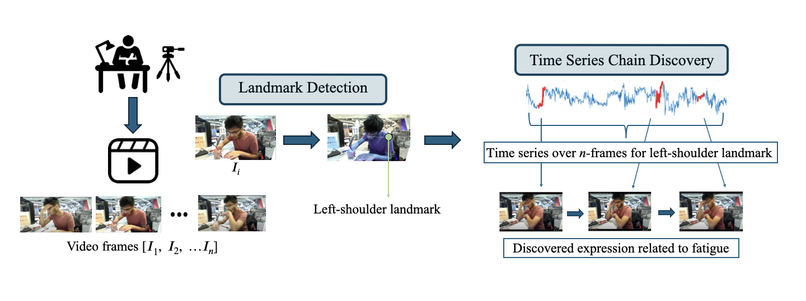
Dataset and Experimental Setup
Recorded three 10-minute videos of sedentary subjects in ergonomic settings, including two videos with subjects in a fatigued state, using a 720p webcam angled at 45 degrees.
Extracted frames from the videos at 10 fps for input to the pose landmark detection model, capturing 3D spatial data of the eyes, shoulders, and mouth.
Applied the robust time series chain discovery algorithm with a subsequence length of 130 (representing 13 seconds) on the depth spatial data of mouth and shoulder landmarks 10 and 11.
Notes:
We collected three videos of approximately ten-minute duration, wherein sedentary human subjects seated in ergonomic environments were simply asked to record themselves working. A built-in camera on the subject’s computer was used to record videos at a resolution of 720p. This webcam was positioned at an angle of approximately 45 degrees in front of the subject and remained fixed on a desk to ensure comprehensive coverage of the subject’s torso, arms, hands, and facial expressions. In two of these recorded videos, subjects were instructed to work while experiencing exhaustion as an additional condition to investigate whether our method of discovering time series chains could discern the subject’s level of energy, emotional state, and activity. Key events relating to all these variables were annotated for each video prior to processing.
We preprocess the video offline by extracting images at a rate of 10 frames per second. Approximately 10,000 frames were extracted for each of our 10-minute videos. Using the pose landmark detection model discussed in the previous slide, we extracted the depth spatial information of the shoulder and mouth landmarks, passing this information as input to the robust time series chain discovery algorithm. We specifically employ a sub-sequence length of 130, representing an action length of13 seconds in the approximately 10-minute video of a tired student working.

Slide 8
Results: Discovered Time Series Chains for Landmarks 10 and 11
Landmark 10 (mouth right)
Consists of 4 chains
Chains are shown in the upper left picture
Landmark 11 (left shoulder)
Consists of 6 chains
Chains are shown in the bottom left picture
Notes:
Through this process we extract the following chains for landmark 10 and 11. With our dataset being a video data stream, we have the unique ability of being able to reference the timestamp of the frame where the chain was detected to discover the captured action within the video itself.

Slide 9
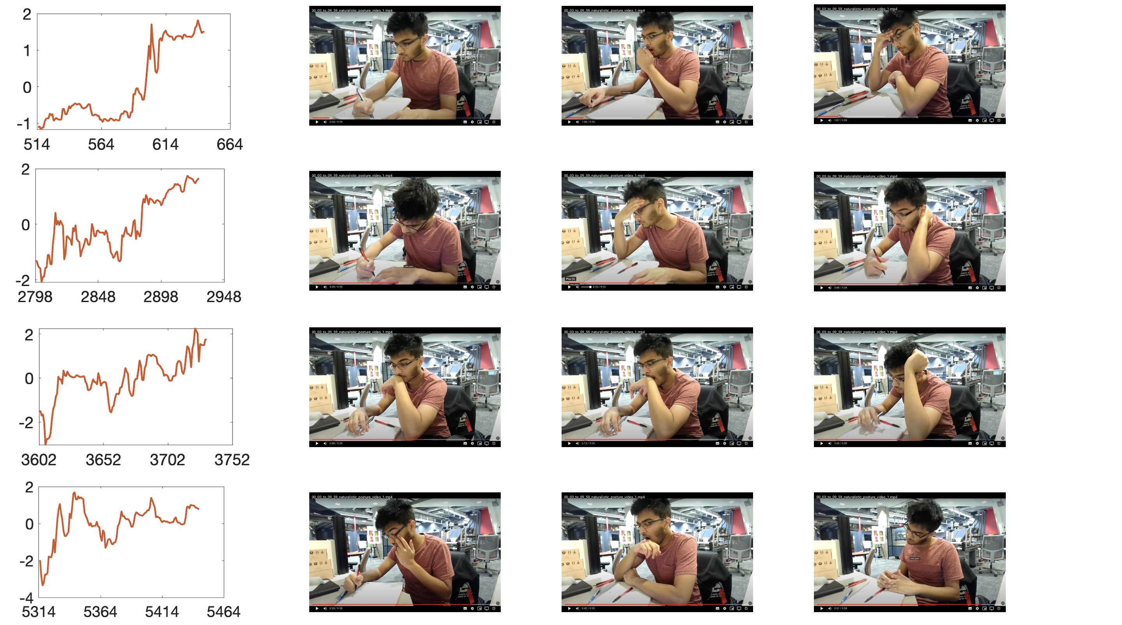
Results: Fatigue Expression Discovery for Landmark 10 (Mouth Right)
Evolving pattern observed in the sequence with writing, yawning, and rubbing left eye transitioning to writing, the student touching their chin, then putting their head down.
Shift in facial expressions and gestures indicative of fatigue progression.
Clear sequence of actions observed with writing followed by yawning and subsequent gestures revealing signs of fatigue.
Notes:
This table showcases the corresponding frames in the video associated with each chain for landmark 10. Here, we can see an evolving pattern over time from the second half of the pattern which corresponds to an action of writing, yawning, and the student rubbing his left eye, to the student writing, touching his chin, then putting his head down. Signs of fatigue are clearly observed throughout with the shift in the facial expressions and gestures indicative of a progression in the fatigue of the student throughout the video.

Slide 10
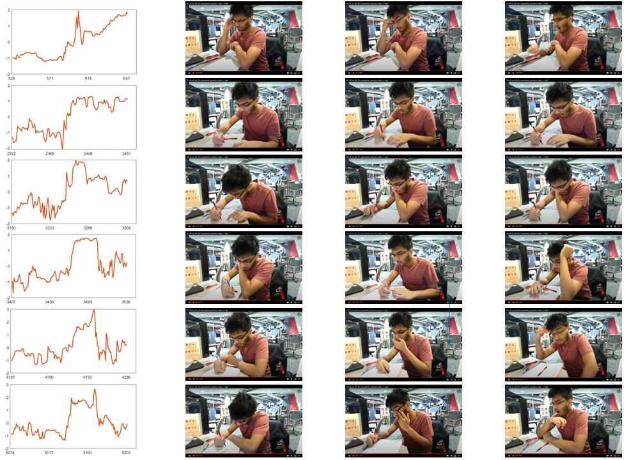
Results: Fatigue Expression Discovery for Landmark 11 (Left Shoulder)
Clear signs of fatigue discovered with the pikes in multiple chains corresponding to yawning during writing.
1st chain peak: Short yawning period with mouth covered by hand, indicating initial fatigue signs.
2nd and 3rd peaks: Prolonged yawning periods during writing, highlighting increased fatigue.
4th, 5th, and 6th peaks: Additional signs of fatigue observed with gestures such as the student rubbing their forehead, nose, and eyes.
Notes:
The time series data for Landmark 11 further showcases the discovery of signs of fatigue with the spikes in the first, second, and third discovered chains all corresponding to yawning while writing in the video. While the peak in the first chain corresponds to a short period of yawning as the student covers his mouth with his hand, we observe a more prolonged period of yawning in the peaks of the second and third chain as the student writes. Further signs of fatigue are observed in the spikes of the fourth, fifth, and sixth discovered chains with the student rubbing his forehead, nose, and eyes in tiredness.

Slide 11
Conclusion
Introduced a new unsupervised method to tackle the problem of discovering expression patterns for human physical fatigue in challenging situations.
Evaluated the performance of our method for fatigue expression discovery with video data recorded in real-world physical fatigue situations.
Plans to further refine the developed unsupervised framework with integration of machine learning algorithms.
Notes:
To summarize, in this work, we introduced a new unsupervised method to tackle the problem of discovering expression patterns for human physical fatigue in challenging real-world situations and demonstrated the effectiveness of robust time series chain discovery as a as a low-cost method for identifying evolving behavior in video data streams. Our future plan involves further refining the developed unsupervised framework with the integration of machine learning algorithms.

Slide 12
Thanks
Adam Haroon
William Carlyon
Frida Cantu
Kofi Nketia Ackaah-Gyasi
Li Zhang
Md Alimoor Reza

